Slide 1


Capacitance, Parallel Plate Capacitor, Cylindrical and Spherical Capacitor, Capacitor in Parallel and in series
Chapter 25: Capacitance

Slide 2
25-1 Capacitance
Learning Objectives
25.01 Sketch a schematic diagram of a circuit with a parallel-plate capacitor, a battery, and an open or closed switch.
25.02 In a circuit with a battery, an open switch, and an uncharged capacitor, explain what happens to the conduction electrons when the switch is closed.
25.03 For a capacitor, apply the relationship between the magnitude of charge q on either plate (“the charge on the capacitor”), the potential difference V between the plates (“the potential across the capacitor”), and the capacitance C of the capacitor.

Slide 3
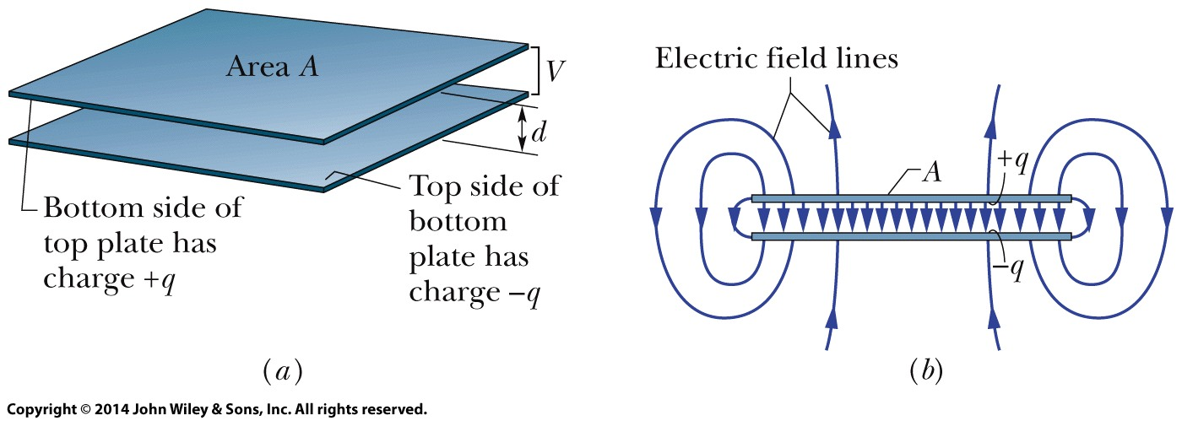
25-1 Capacitance
A capacitor consists of two isolated conductors (the plates) with charges +q and -q. Its capacitance C is defined from
where V is the potential difference between the plates.
A parallel-plate capacitor, made up of two plates of area A separated by a distance d. The charges on the facing plate surfaces have the same magnitude q but opposite signs
As the field lines show, the electric field due to the charged plates is uniform in the central region between the plates. The field is not uniform at the edges of the plates, as indicated by the “fringing” of the field lines there.

Slide 4
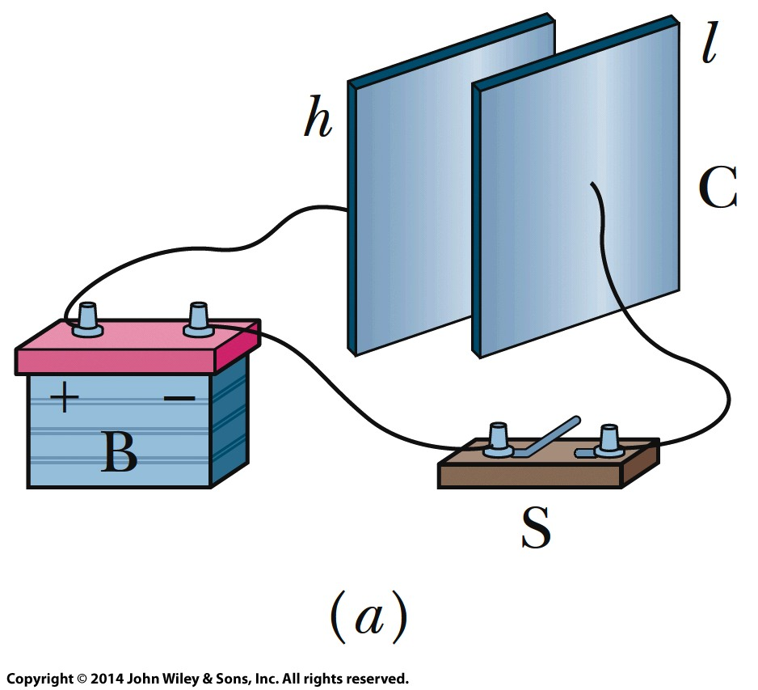
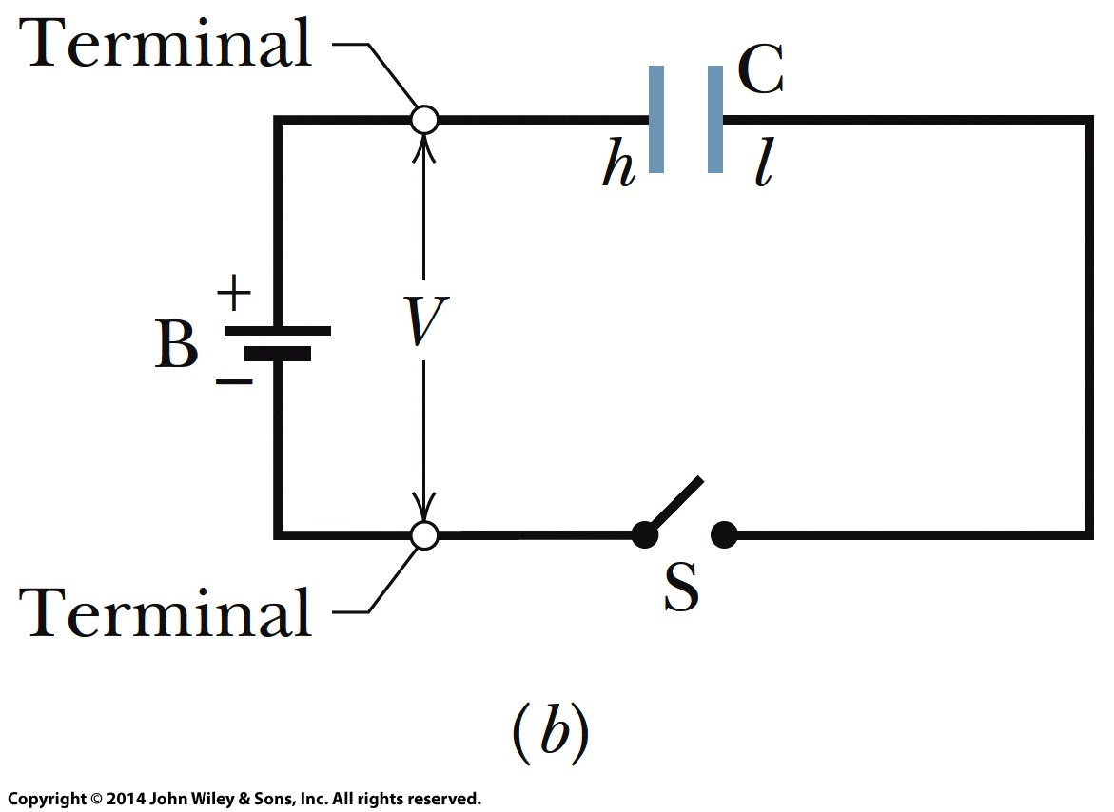
25-1 Capacitance
Charging Capacitor
When a circuit with a battery, an open switch, and an uncharged capacitor is completed by closing the switch, conduction electrons shift, leaving the capacitor plates with opposite charges.
In Fig. a, a battery B, a switch S, an uncharged capacitor C, and interconnecting wires form a circuit. The same circuit is shown in the schematic diagram of Fig. b, in which the symbols for a battery, a switch, and a capacitor represent those devices. The battery maintains potential difference V between its terminals. The terminal of higher potential is labeled + and is often called the positive terminal; the terminal of lower potential is labeled - and is often called the negative terminal.

Slide 5
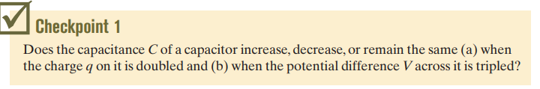

Slide 6
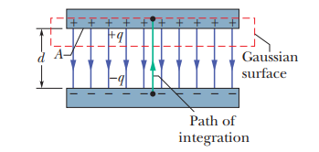
25-2 CALCULATING THE CAPACITANCE
Assume a charge q on the plates;
Calculate the electric field between the plates in terms of this charge, using Gauss’ law
Calculate the potential difference V between the plates from
Calculate capacitance C

Slide 7
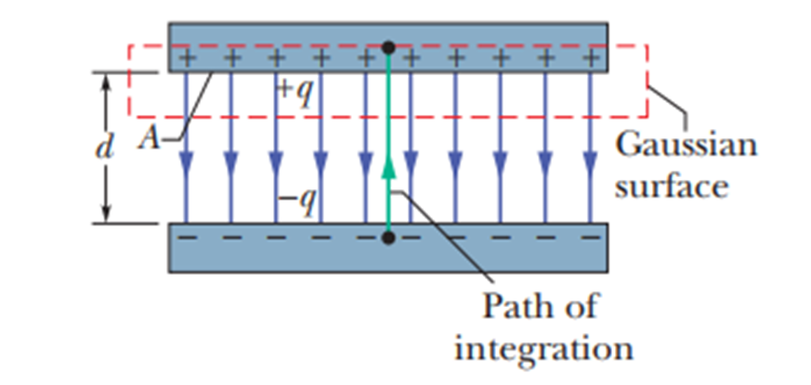

A Parallel-Plate Capacitor

Slide 8
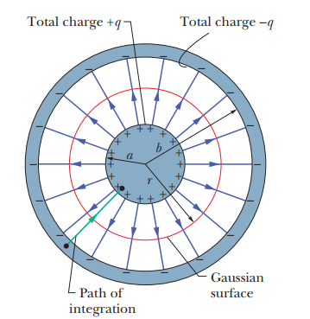

A Cylindrical Capacitor

Slide 9
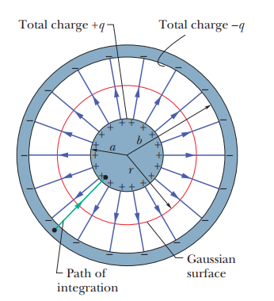

A Spherical Capacitor

Slide 10
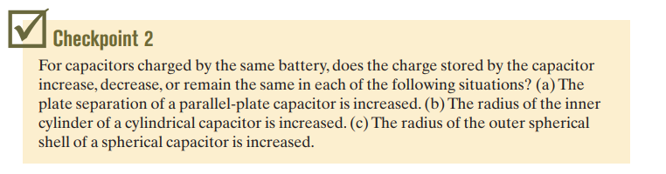

Slide 11
25-3 Capacitors in Parallel and in Series
Learning Objectives
25.06 Sketch schematic diagrams for a battery and (a) three capacitors in parallel and (b) three capacitors in series.
25.07 Identify that capacitors in parallel have the same potential difference, which is the same value that their equivalent capacitor has.
25.08 Calculate the equivalent of parallel capacitors.
25.09 Identify that the total charge stored on parallel
capacitors the sum of the charges stored on the individual capacitors.
25.10 Identify that capacitors in series have the same charge, which is the same value that their equivalent capacitor has.
25.11 Calculate the equivalent of series capacitors.
25.12 Identify that the potential applied to capacitors in series is equal to the sum of the potentials across the individual capacitors.

Slide 12
25-3 Capacitors in Parallel and in Series
Learning Objectives (Cont’d.)
25.13 For a circuit with a battery and some capacitors in parallel and some in series, simplify the circuit in steps by finding equivalent capacitors, until the charge and potential on the final equivalent capacitor can be determined, and then reverse the steps to find the charge and potential on the individual capacitors.
25.14 For a circuit with a battery, an open switch, and one or more uncharged capacitors, determine the amount of charge that moves through a point in the circuit when the switch is closed.
25.15 When a charged capacitor is connected in parallel to one or more uncharged capacitors, determine the charge and potential difference on each capacitor when equilibrium is reached.

Slide 13

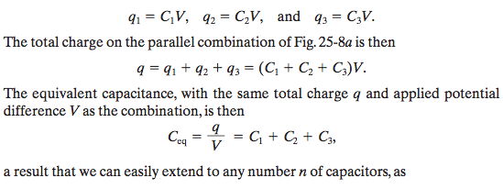
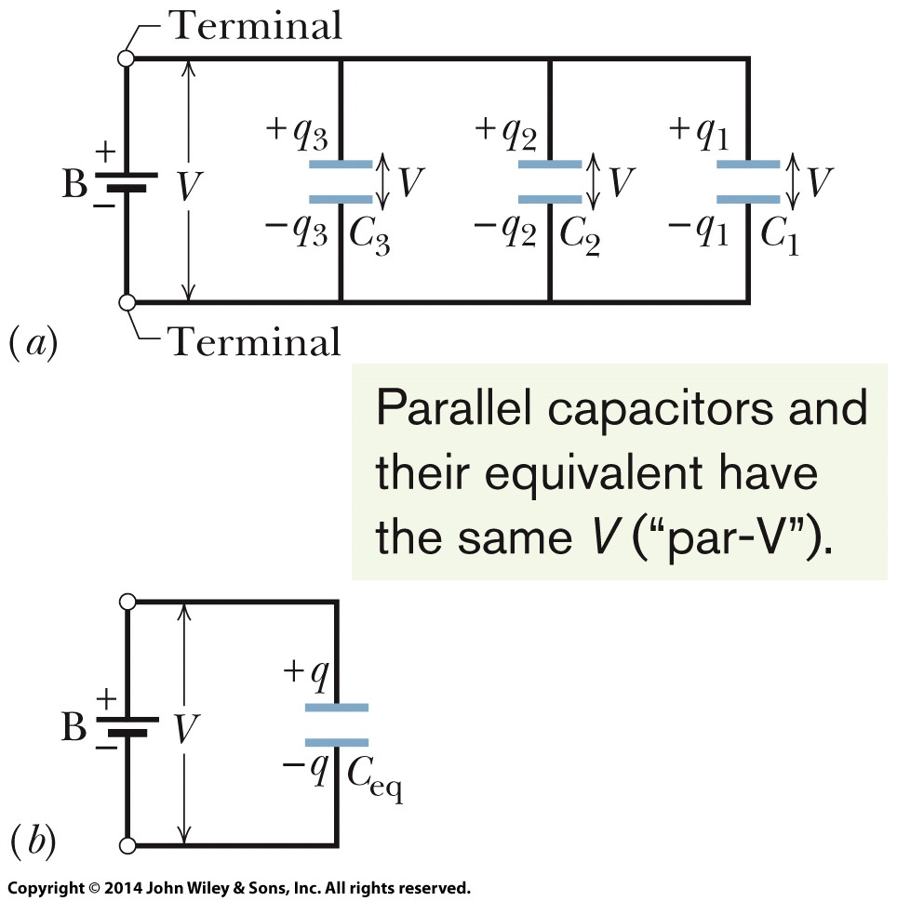


25-3 Capacitors in Parallel and in Series
Capacitors in Parallel

Slide 14

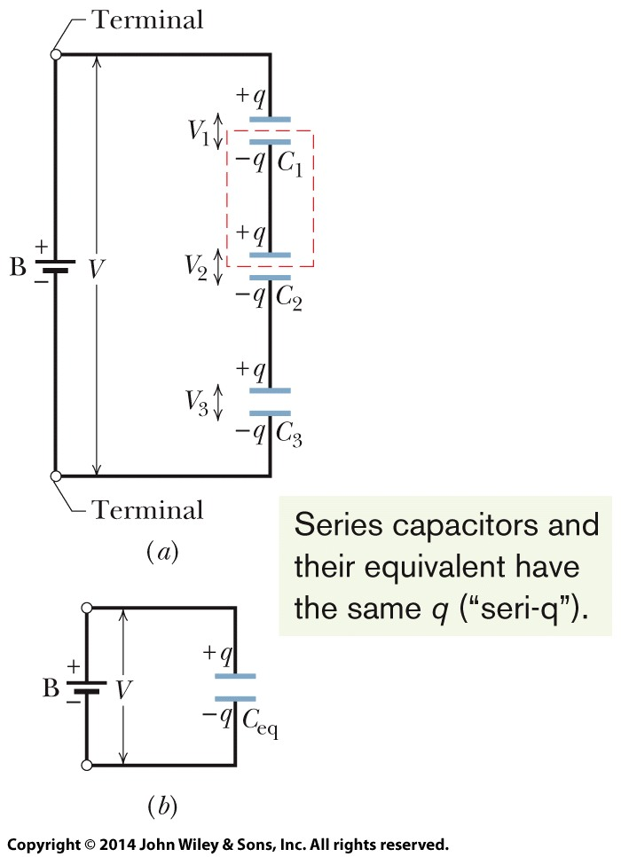
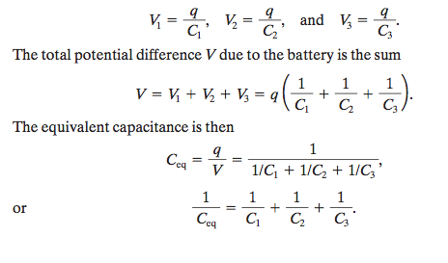


25-3 Capacitors in Parallel and in Series
Capacitors in Series

Slide 15








25 Summary
Capacitor and Capacitance
The capacitance of a capacitor is defined as:
Capacitor in parallel and series
In parallel:
In series
Eq. 25-19
Eq. 25-1
Determining Capacitance
Parallel-plate capacitor:
Cylindrical Capacitor:
Spherical Capacitor:
Isolated sphere:
Eq. 25-20
Eq. 25-9
Potential Energy and Energy Density
Electric Potential Energy (U):
Energy density (u)
Eq. 25-14
Eq. 25-21&22
Eq. 25-17
Eq. 25-25
Eq. 25-18
Notes:
3

Slide 16

25 Summary
Capacitance with a Dielectric
If the space between the plates of a capacitor is completely filled with a dielectric material, the capacitance C is increased by a factor κ, called the dielectric constant, which is characteristic of the material.
Gauss’ Law with a Dielectric
When a dielectric is present, Gauss’ law may be generalized to
Eq. 25-36
Notes:
3

